Slide 1
Capstone Project
Seoul Bike Sharing Demand Prediction
By Rupali Sawant

Slide 2
Content
Defining problem statement
Data summary
Performing exploratory data analysis
Model preparation
Building different models
Models used
Challenges faced
Conclusion

Slide 3
Define the problem statement
Rental bikes services is a very crucial in many urban cities for the enhancement of mobility comfort. It is important to make the rental bike available and accessible to the public at the right time as it lessens the waiting time.
Eventually, providing the city with a stable supply of rental bikes becomes a major concern.
Therefore we have to predict the number of rental bikes required in each hour for smooth functioning of service.

Slide 4
Data summary
The given dataset containing count of rental bikes from December 2017 to November 2018 for each day and each hour of day. Along with the count of rental bikes there are following variables are present.
(1)Date : year-month-day
(2)Rented Bike Count : Count of bikes rented at each hour
(3)Hour :Hour of the day
(4)Temperature : Temperature –Celsius
(5)Humidity : %
(6)Windspeed :m/s
(7)Visibility : 10m
(8)Dew point temperature : Celsius
(9)Solar radiation :MJ/m2

Slide 5
Data summary cont…
(10)Rainfall :mm
(11)Snowfall : cm
(12)Seasons : Winter, Spring, Summer, Autumn
(13)Holiday : Holiday/No holiday
(14)Functional Day : No(Non Functional Hours), Yes(Functional Hours)
‘Rented Bike count’ is dependent variable.

Slide 6
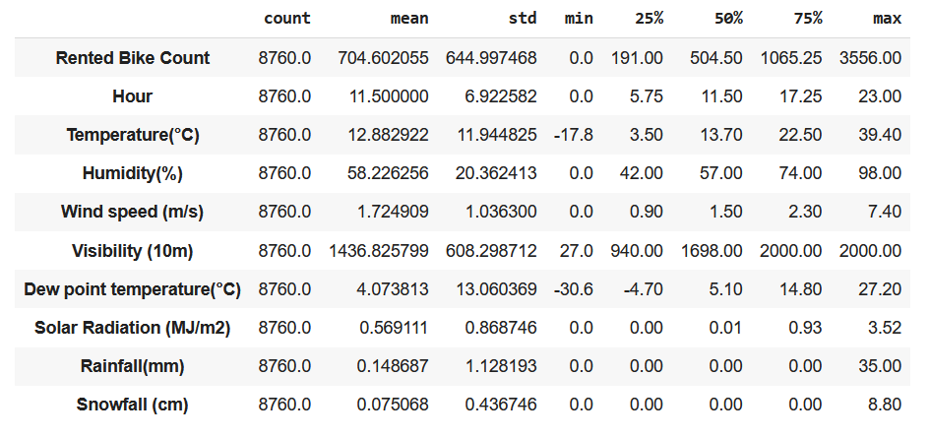
Description of data
The Dataset contains 8760 lines and 14 columns.
In a day we have 24 hours and 365 days a year so 365 multiply by 24 = 8760 , which is represent the number of lines in the dataset.

Slide 7
Exploratory data analysis
Exploratory Data Analysis refers to the critical process of performing initial investigations on data so as to discover patterns, to spot anomalies , to a test hypothesis and to check assumptions with the help of summary statistics and graphical representations.
EDA is a through examination meant to uncover the underlying structure of a dataset and is important for a company because it exposes trends, pattern and relationship that are not readily apparent.

Slide 8
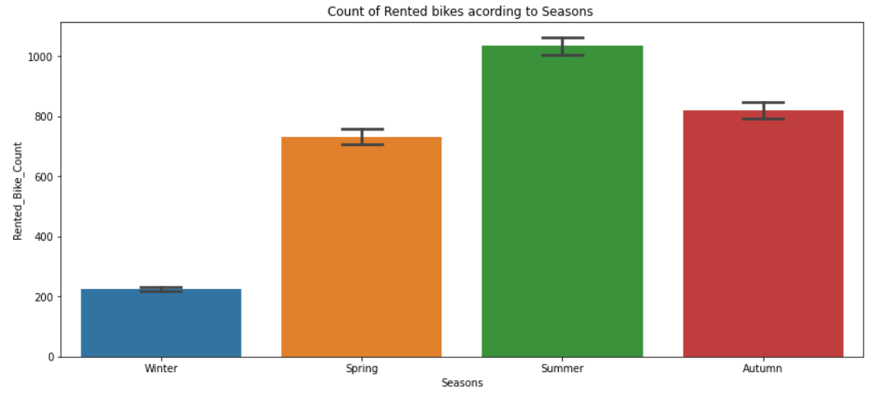
Count of rented bikes according to seasons
In this bar plot shows the use of rented bikes in a four different seasons, and it clearly shows that,
1. In summer season the use of rented bikes is high and peak time 7am – 9am and 7pm – 9pm
2. In winter season the use of rented bike is very low because of snowfall.

Slide 9
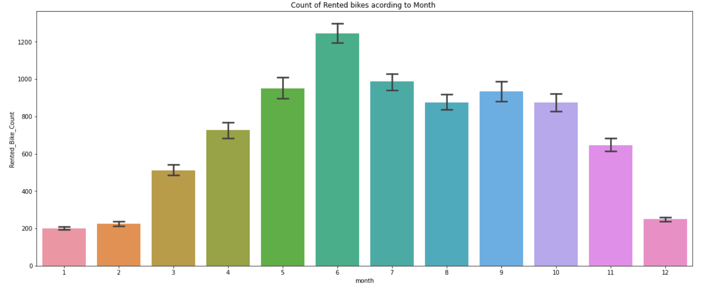
Count of rented bikes according to Month
From the above bar plot we can say that from the month 5 to 10 the demand of rented bikes is high as compare to other months. These months are comes inside the summer seasons.

Slide 10
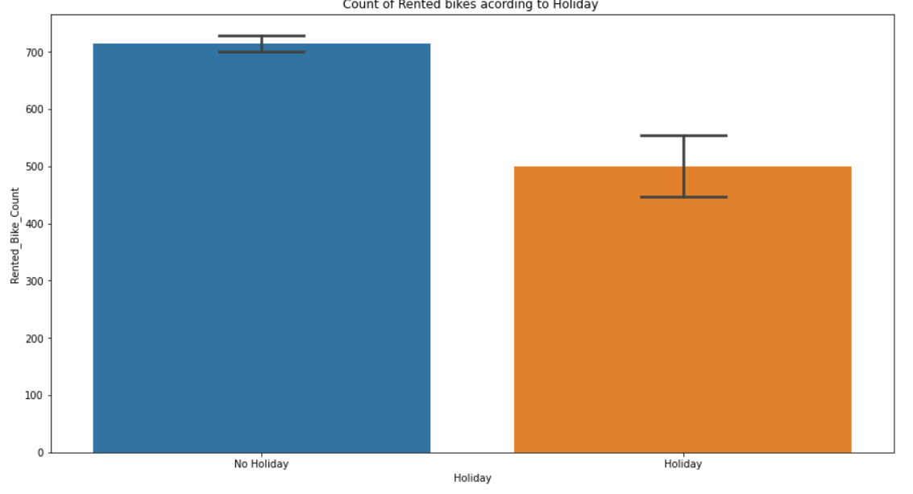
Count of rented bikes according to holidays
In this bar plot which shows the use of rented bikes in a holiday and it clearly shows that,
Holiday peoples use the rented bikes from 2pm – 8pm.

Slide 11
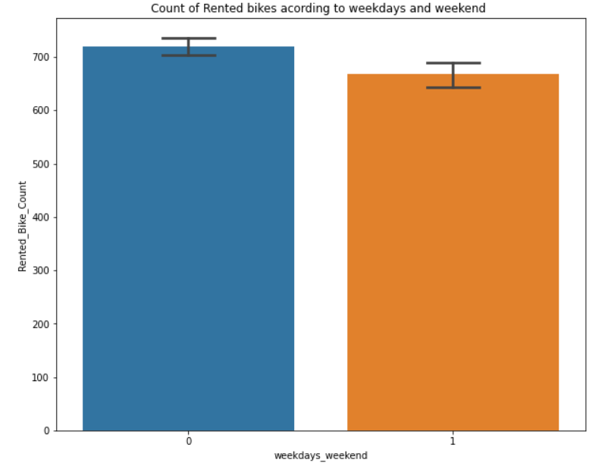
Count of rented bikes according to Weekdays weekend
From the above bar plot we can say that in the weekdays which represent in the blue color shows that the demand of bike is higher because of the office.
Peak time are 7am – 9am and 5pm – 7pm.
The orange color represent the weekend days and shows that the demand of rented bikes is very low specially in the morning hour but when the evening start from 4pm – 8pm the demand slightly increases.

Slide 12
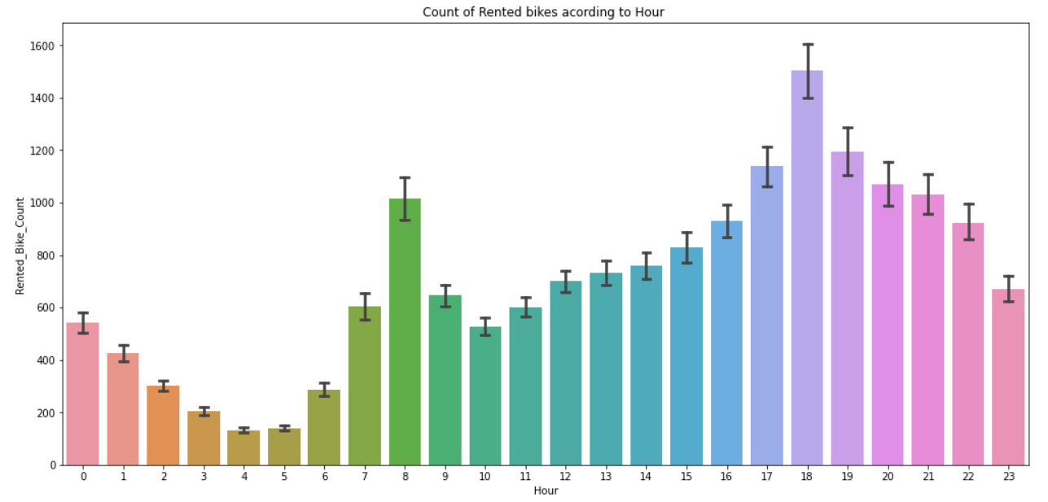
Count of rented bikes according to hour
In the above bar plot which shows the use of rented bikes according to the hours and the data from all over the year.
Generally people use rented bikes during their working hour from 7am-9am and 5pm-7pm.

Slide 13
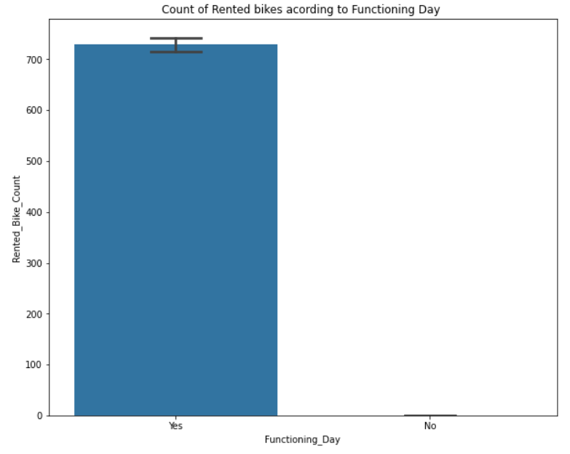
Count of rented bike according to functioning day
From the above bar plot which shows the use of rented bike in functioning day or not, and it clearly shows that ,
Peoples don’t use rented bikes in non functioning day.

Slide 14
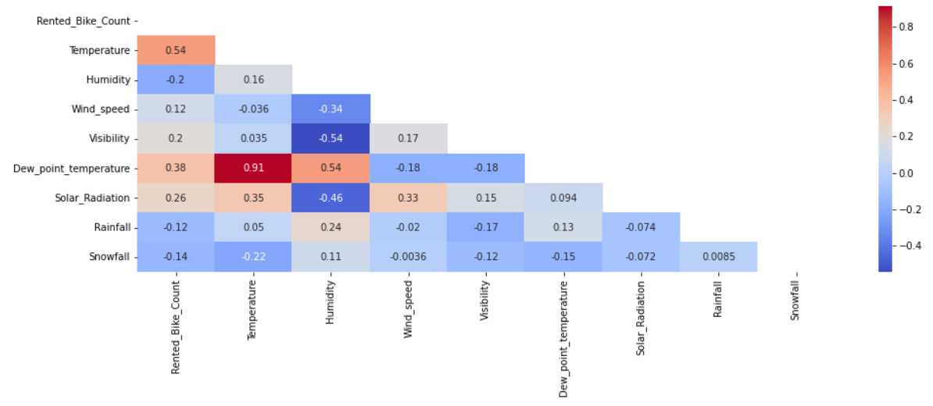
Heatmap
We can observe in the heatmap that on the target variable line the most positively correlated variables to the rent are :
The temperature
The dew point temperature
The solar radiation
And most negatively correlated are :
Humidity
Rainfall

Slide 15
Model preparation
1. Calculating the multicollinearity through VIF and filtering our data.
2. Converting data types of variables into relevant data types.
3. Filling the null values in our data with mean of particular values.

Slide 16
Models used
Linear regression model
Lasso regression model
Ridge regression model
Decision tree regression model
Random-forest regression model
Extra-trees regression model
Elastic net regression model

Slide 17
Challenges faced
Pre-processing the data was one of the challenges we faced which includes removing highly correlated variables from the data so as to not a hinder the performance of our regression model.
Exploring all the columns and calculating VIF for multicollinearity was challenging because it might decrease the models performance.
Selecting the appropriate models to maximize the accuracy of our predictions was one of the challenges faced.

Slide 18
Conclusion
Coming from the beginning we did EDA on the dataset and also cleaned the data according to our needs. After that we were able to draw relevant conclusions from the given data and then we trained our model on linear regression and the other models.
Out of all the models used, with extra-trees regression model we were able to get the r2 score 99% and 95% respectively and the model perform poorly was a elastic net regularization with r2 score of 92%.
No overfitting is seen
Given the size of data and the amount of irrelevance in the data,the above score is good.

Slide 19
Thank You

